Slide 1
Physical Accessibility of Alcohol and Alcohol Purchasing Among Low-Income Households
Three and four variable relationships
Raj Kumar Subedi
PHPH 9120
10/08/2026
Notes:
Hello everyone. In Assignment 1, I proposed that households living closer to an alcohol outlet spend a larger share of their income on alcohol. Today I am extending that relationship to three and four variables. I will cover the operational linkage, introduce a third variable and test it in all three causal roles, state a three-variable hypothesis, add a fourth variable that names the mechanism, and finish by evaluating the model.

Slide 2

Where we left off, and what changed
Network distance to
nearest off-premise outlet
–
Alcohol spending as
% of monthly income
Among low-income households, the shorter the network distance to the nearest off-premise outlet, the greater the share of monthly income spent on alcohol.
One change from Assignment 1
The hypothesis itself is unchanged. However, I now explicitly state the association as negative. The subsequent slides build on this negative relationship.
Notes:
Let me start by restating where Assignment 1 ended. My independent variable is the network distance from a household's residence to the nearest off-premise alcohol outlet. My dependent variable is alcohol spending as a percentage of monthly household income. The relationship I predicted is negative: the closer the outlet, the larger the share of income spent.
The hypothesis itself has not changed. I now specify the form as negatively accelerated, and as you will see, that shape is what the rest of my model has to explain.

Slide 3
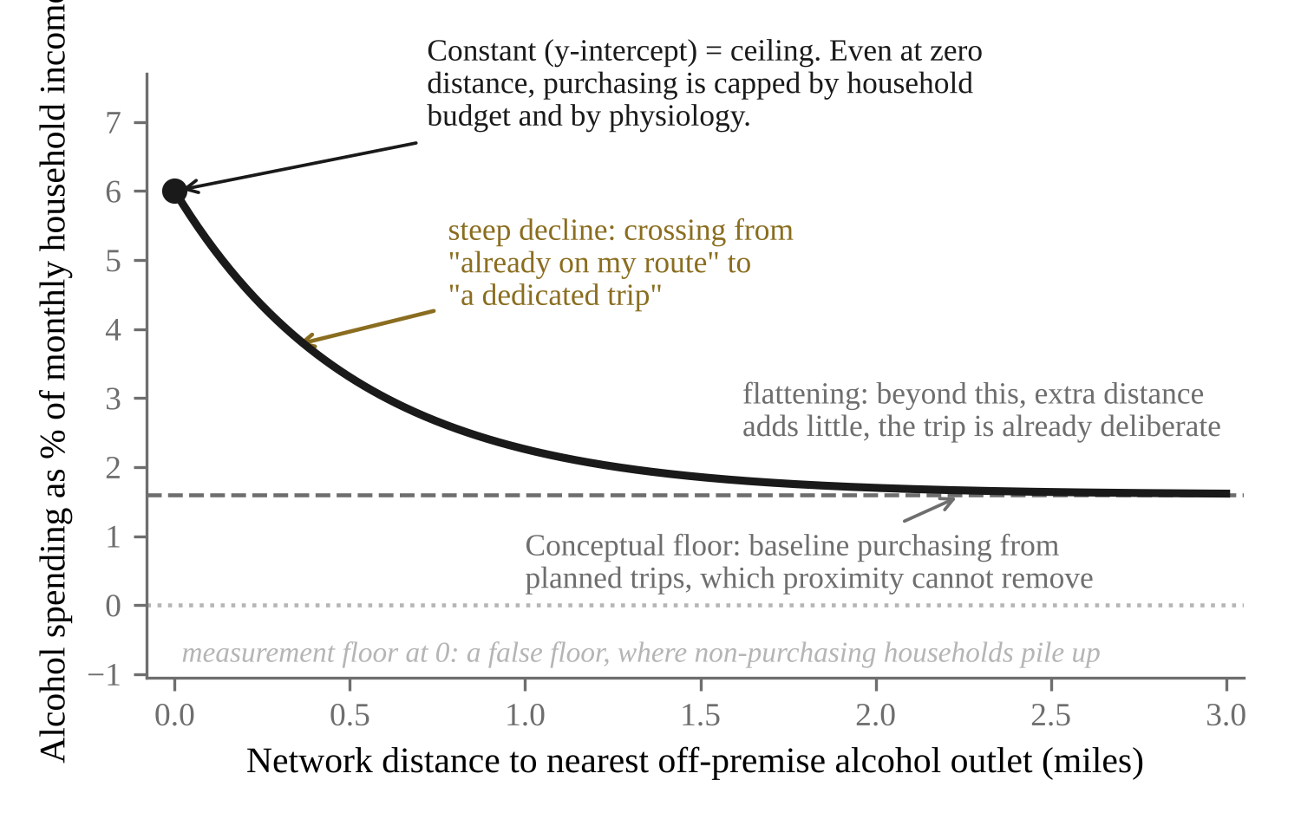
The operational linkage
Form
Negatively accelerated. Steep, then flattening. Not linear, not S-shaped.
Direction
Negative. More distance, less spending share.
Coefficient
Moderate, about r = −0.25 to −0.35.
Limit
Ceiling at zero distance; non-zero floor far away. The line at 0 is a false floor from the measure.
Constant
Conceptual illustration, not data
The y-intercept sits at the ceiling, not at the origin.
Why this shape? What matters is whether the outlet sits on a route you already travel. That threshold is crossed within a few blocks, which gives the steep segment. Once the trip is already deliberate, another mile changes little.
Notes:
This is the operational linkage, and the assignment asks for four elements, so let me take them in order.
The form is negatively accelerated. Spending share falls steeply over the first half mile and then flattens out.
The direction is negative. More distance means a smaller share of income spent.
The coefficient is moderate, not strong. I would expect a correlation around negative point two five to negative point three five, because accessibility is competing with price, with dependence, and with drinking norms.
The limit is the part I want to spend a moment on. There are two of them. On the left there is a ceiling, because even if the store is at your doorstep, purchasing is capped by your budget and by your body. On the right there is a conceptual floor above zero, because some purchasing happens on deliberate planned trips no matter how far the store is. Proximity adds to that baseline, but it cannot remove it. The dotted line at zero is different. That is a false floor imposed by my measure, because spending share cannot be negative and every non-purchasing household piles up at exactly zero.
That brings me to the constant. My y-intercept sits at the ceiling, not at the origin, because perfect accessibility does not create purchasing out of nothing. It acts on households that already have some propensity to buy.
And the reason for this shape is the bar at the bottom. What matters is whether the store is on a route you already travel. That changes within a few blocks, which is why the curve is steep there and flat later.

Slide 4


The third variable
Private vehicle access
CONCEPT
Whether a working vehicle is available for routine trips.
Household mobility resources
The means available to a household for covering physical distance in the course of its daily activities.
Public transit access
Proximity and service frequency of transit at the residence.
Low income stays the scope condition, not this variable. Within low-income households, vehicle access varies a great deal, and that variation is exactly what I want.
Variable: household vehicle access
Transit routes are fixed and do not adapt to the errand being run.
Notes:
My third variable is household mobility resources, which I define as the means available to a household for covering physical distance in the course of its daily activities.
I propose two subdimensions. The first is private vehicle access, meaning whether a working vehicle is available for routine trips. The second is public transit access, meaning how close transit is and how often it runs.
The variable I will actually use is household vehicle access. I chose private vehicle access over transit because a bus route is fixed (a variable has to vary), whereas a car turns a distance into a short trip.
One clarification before I go on, because it is the question I would ask. Low income is still my scope condition, not my third variable. Within low-income households, vehicle access varies a great deal, and that variation is exactly what I am interested in.

Slide 5
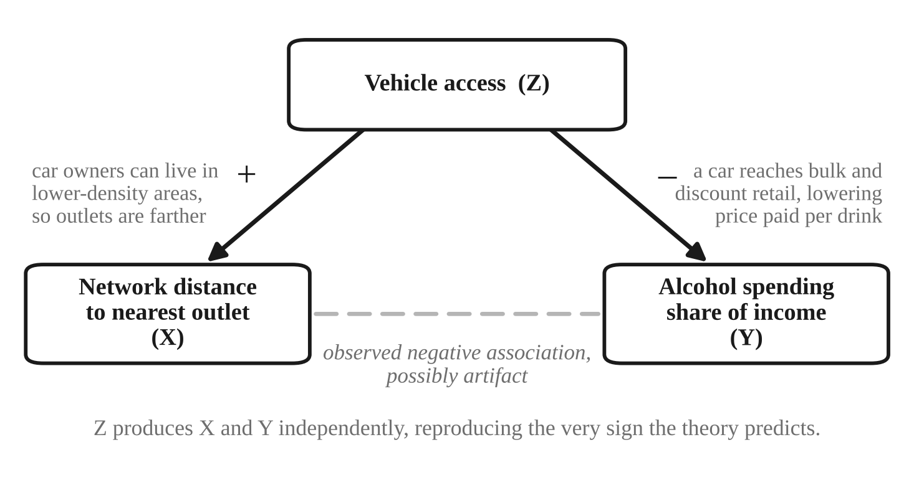
Role 1: spurious
On the X side: households with a car can live in lower-density areas where outlets are spaced further apart. Carless households are pushed toward dense neighborhoods where outlets cluster.
On the Y side: a car reaches discount retail and allows bulk buying, which lowers the price paid per drink and the share of income spent.
So the pattern I predicted could appear even if being near a store changes nothing.
This confounder imitates my theory rather than muddling it (hence needs to be controlled in the model as a confounder too)
Notes:
The first role is spurious, where the third variable causes both of my variables and the relationship between them is an artifact.
Vehicle access can do this, and by two different mechanisms. On the independent variable side, a household with a car can afford to live in a lower-density area where stores are spread further apart, while a household without one is pushed toward a dense neighborhood where outlets cluster. So vehicle access increases distance, through residential sorting.
On the dependent variable side, having a car lets you reach a supermarket or a discount retailer and buy in bulk, which lowers what you pay per drink and therefore lowers your spending share.
Put those together and vehicle access would produce a negative association between distance and spending even if proximity did nothing at all. I want to be clear that this is a serious threat and not a token one, because it reproduces exactly the sign my theory predicts.

Slide 6
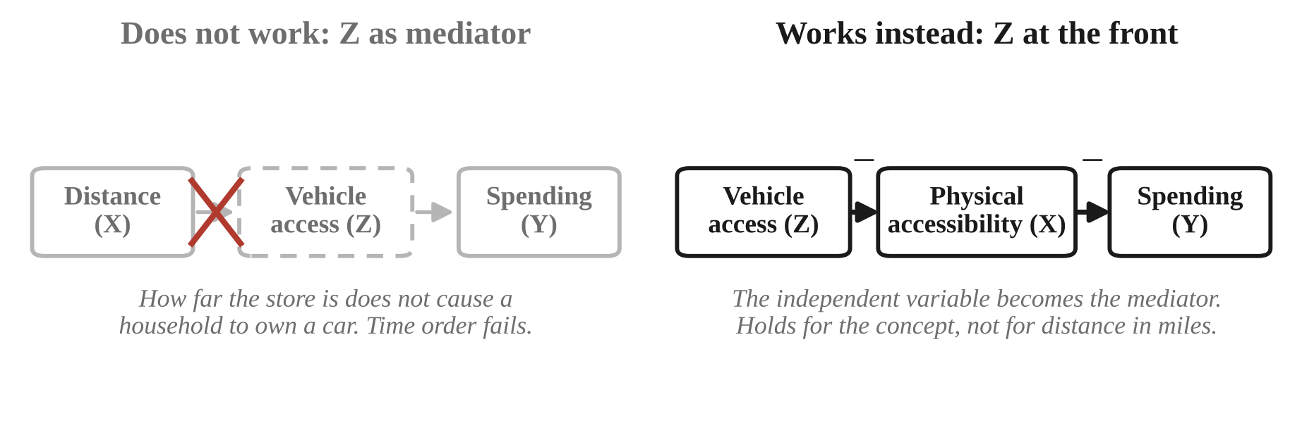
Role 2: mediation
Why it doesn’t make sense. Mediation needs X to cause Z. Nobody has ever stood in their driveway and thought, ‘the liquor store is two miles away -- time to buy a Honda.'
What works instead. Put vehicle access first, and my own independent concept becomes the mediator.
Notes:
The second role is mediation, and this is the one that does not work, so let me flip it rather than force it.
Mediation requires that my independent variable cause the third variable. But how far a household lives from a liquor store does not cause that household to acquire or lose a car. The time order simply fails. Nobody has ever stood in their driveway and thought, ‘the liquor store is two miles away -- time to buy a Honda.'
What does work is turning it around. If I put vehicle access at the front, then my own independent concept becomes the mediator: having a vehicle reduces the effort of obtaining alcohol, and that reduced effort raises purchasing.
There is a catch worth naming, because it is the interesting part. That chain holds for my concept, which I defined as obtaining alcohol with little expenditure of time, travel, and effort. It does not hold for my measure, because network distance in miles is fixed by geography and does not change when a household buys a car. That gap between the concept and the measure is itself a reason I did not choose this role.

Slide 7
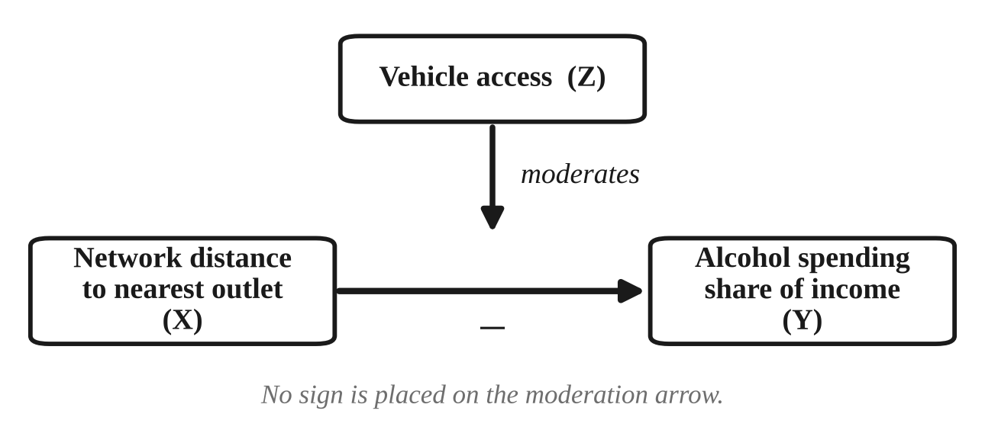
Role 3: moderation (the role I choose among the three)
Distance acts on purchasing through travel cost, and travel cost depends on how the trip is made.
With a car, half a mile costs a few minutes and folds into an existing trip. The slope will be small.
Without a car, the same half mile is walked, often carrying the purchase home. The slope should be steep.
Why moderation over the other two
Mediation is ruled out by time order. The spurious role is real, it can be handled by controlling for vehicle access, not by abandoning the causal claim. Moderation is the only one of the three that states something my theory actually predicts rather than something it (my theory) merely has to survive.
Notes:
The third role is moderation, and this is the one I choose.
The logic is straightforward. Distance acts on purchasing through travel cost, and travel cost depends entirely on how you make the trip. For a household with a car, half a mile is a few minutes and folds into a trip you were making anyway, so proximity should barely play a determining role (or register) and the slope should be shallow. For a household without a car, that same half mile has to be walked which takes several minutes, and the person has to carry the purchased alcohol back home, so proximity plays a dominant role and the slope should be steep.
Let me say why I picked this over the other two. Mediation is ruled out by time order, as I just showed. The spurious story is real, but the right response to a confound is to control for it, not to abandon the causal claim. Moderation is the only one of the three roles that states something my theory actually predicts, rather than something my theory merely has to survive.

Slide 8
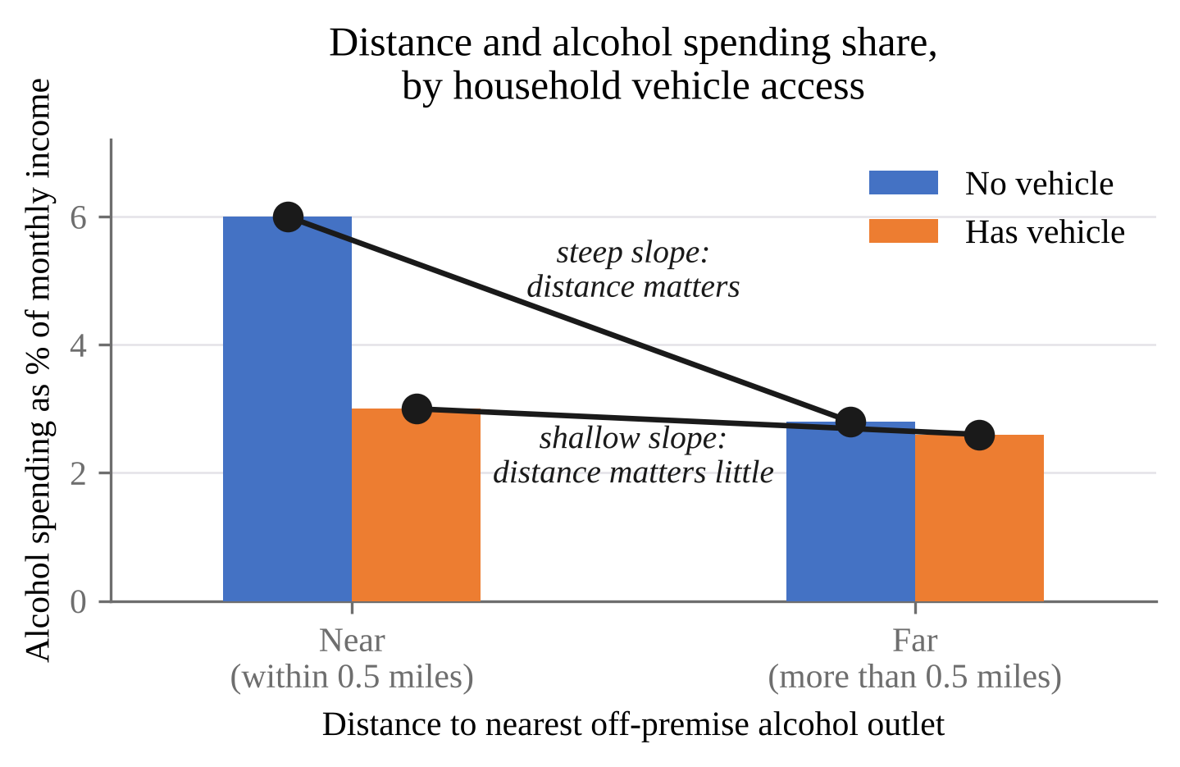
Three-variable hypothesis
Among low-income households, vehicle access moderates the relationship between distance to the nearest off-premise outlet and the share of monthly income spent on alcohol, such that among households without a vehicle, those living within half a mile will spend a substantially higher share than those living farther away; whereas among households with a vehicle, those living within half a mile will spend only slightly more than those living farther away.
Non-parallel slopes are the interaction. Parallel bars would mean no moderation.
Households without cars show a steep drop from near to far.
Households with a vehicle have low slope.
Notes:
Here is the hypothesis, and I have written it to cover both levels of the moderator so that there is no ambiguity.
Among low-income households, vehicle access moderates the relationship between distance to the nearest off-premise outlet and the share of monthly income spent on alcohol, such that among households without a vehicle, those living within half a mile of an outlet will spend a substantially higher share of their income on alcohol than those living farther away; whereas among households with a vehicle, those living within half a mile will spend only slightly more than those living farther away.
The chart shows the pattern I am predicting. The blue bars are households with no vehicle and the orange bars are households with one. The important thing is not the heights of the bars but the slopes of the lines drawn across them. The carless line drops sharply from near to far. The vehicle line is almost flat. Non-parallel slopes are what an interaction looks like. If those two lines came out parallel, I would have no moderation.

Slide 9
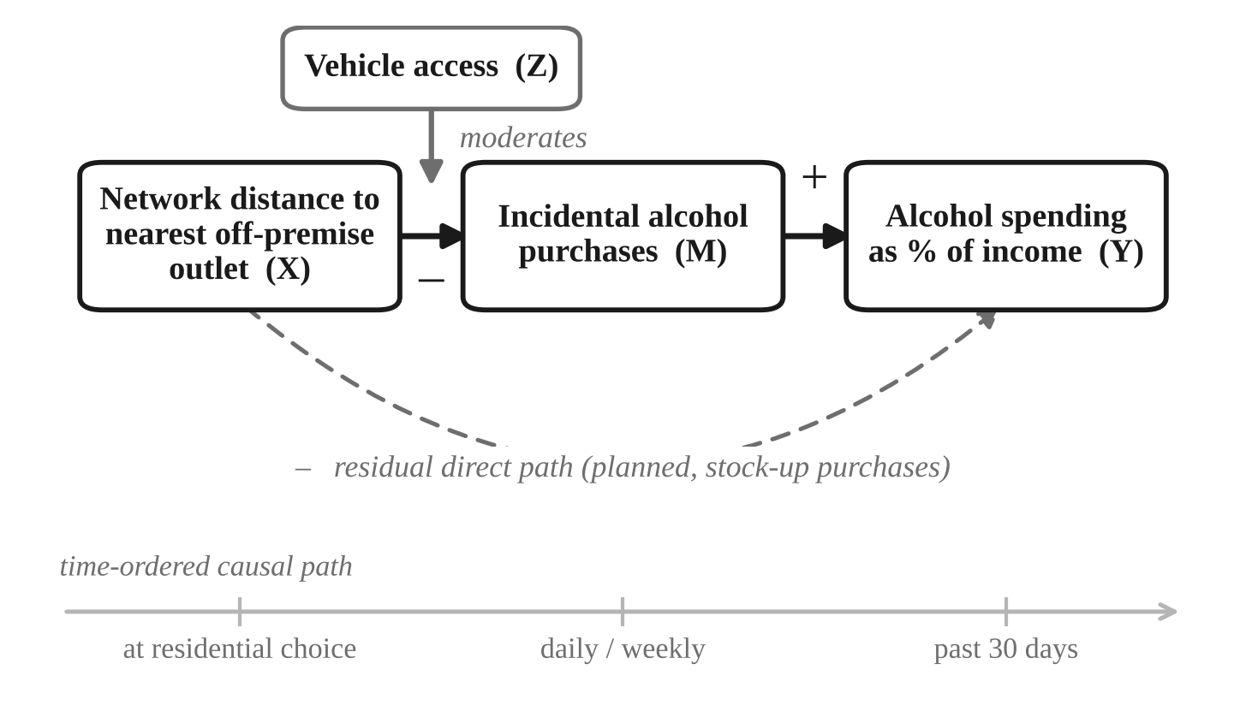
The fourth variable, and the full model
FOURTH VARIABLE
Incidental alcohol purchases
Buying alcohol while out for some other reason: fuel, groceries, the way home.
Without it, the theory is a black box: proximity raises spending by unstated means.
It makes the claim falsifiable. The effect should run through incidental trips, not larger planned ones.
It explains the curve in Part A: an incidental buy needs the outlet on an existing route.
Defined by trip purpose, not by intent, so it is measurable with one survey item.
Vehicle access now moderates the distance-to-incidental-purchases path. Naming the mechanism locates the interaction more precisely.
Notes:
My fourth variable is incidental alcohol purchases, which I define as how often household members buy alcohol while they are out for some other reason, such as getting fuel, shopping for groceries, or travelling home.
I need it because without it my theory is a black box. The earlier models say that proximity raises spending, but they never name the behavioral event through which that happens, and a model that cannot name its own mechanism is very hard to falsify. With this variable, my prediction becomes specific: proximity should raise spending by multiplying incidental purchases, not by making planned stock-up trips bigger. If it turned out that proximity worked entirely through planned purchases, my candy-at-checkout analogy would be wrong even though my two-variable hypothesis survived.
It also explains the curve from earlier, because an incidental purchase requires the store to sit on a route you are already travelling, and that is only true at short distances.
One measurement note. I define it by what the trip was for, not by what the shopper intended, so nobody has to report their own state of mind.
vehicle access now moderates the path from distance to incidental purchases rather than the overall relationship. The dashed line underneath is the residual direct path through planned purchases, and my theory predicts it is the smaller of the two routes.

Slide 10
Evaluating the model
High
Testability
Every construct has a data source: licensing records, geocoding, survey items.
High
Falsifiability
Form, interaction, and indirect path could each fail on their own.
Medium
Parsimony
Four variables, one interaction, one mediator. Lean, but no longer simple.
Medium
Explanatory power
Credible mechanism, modest variance. Price and dependence are untheorized.
Low
Formal development
Stated verbally and in diagrams, not as a specified mathematical model.
The strengths are conceptual, the weaknesses is formalization. Both are fixable.
Notes:
Finally, to evaluate the model on five criteria.
Testability is high. Every construct has an operational definition and an identifiable data source: state licensing records and geocoding for distance, single survey items for vehicle access and incidental purchases, and the items from Assignment 1 for spending share.
Falsifiability is also high, and I want to stress this one. The form could come out linear instead of decelerating. The interaction with vehicle access could be null or reversed. The indirect path through incidental purchases could turn out smaller than the direct path. Any one of those would disconfirm a specific claim.
Parsimony is medium. Four variables with one interaction and one mediator is small compared with a full ecological model, but it is more complex than the two variable relationship.
Explanatory power is medium. I specify a credible mechanism, but I explain variation in spending among households that already have some propensity to buy. I do not explain the propensity itself, and price, dependence, and neighborhood context are all untheorized.
Degree of formal development is low, tbh. My theory is stated in words and in diagrams, not as a mathematical model with named parameters. Turning the diagram into a specified structural model with a nonlinear term for distance is the next step.
So the strengths of this model are on the conceptual side and the weaknesses are in its formalization. Happy to take questions. Thank you.

Slide 11
Python codes used to generate the figures:
Happy to Take Questions. Thank you.

